Slide 1
Team 11 Topic: Text Analytics Subject: INFO7390 Advances Data science/Architecture
Date : 04/08/2017

Slide 2
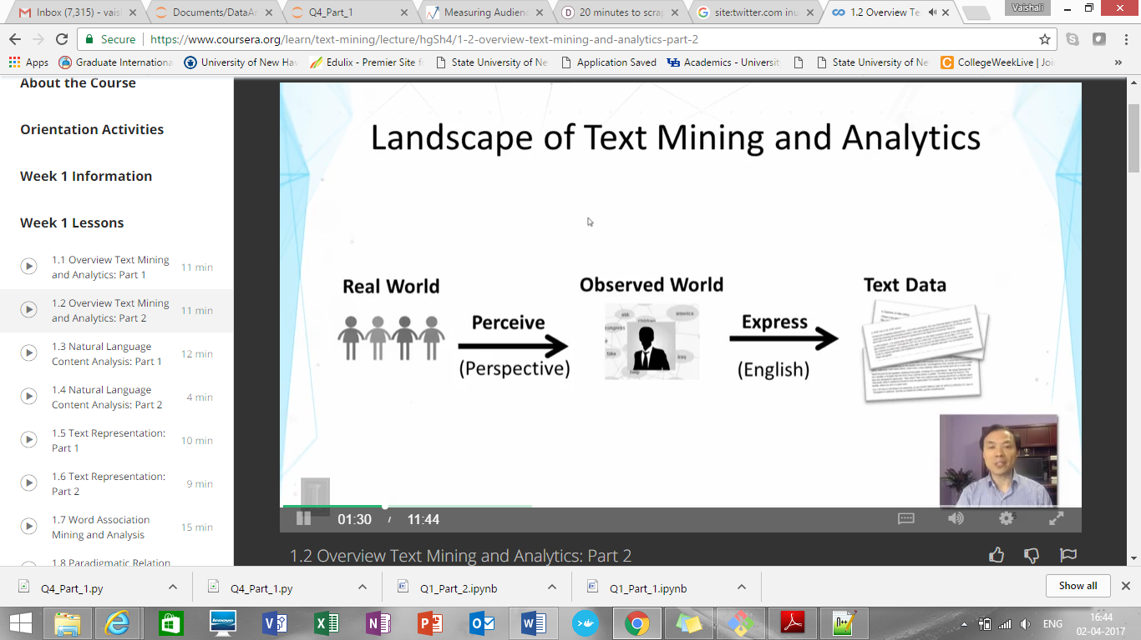
What is text analytics ?
Text mining ~ Text analytics
Turn text data into high quality information or actionable knowledge

Slide 3
Subtasks in text analytics
Information retrieval or identification of a corpus is a preparatory step: collecting or identifying a set of textual materials, on the Web or held in a file system, database, or content corpus manager, for analysis.
Apply advanced statistical methods: apply more extensive natural language processing, such as part of speech tagging, syntactic parsing, and other types of linguistic analysis.
Named entity recognition is the use of gazetteers or statistical techniques to identify named text features: people, organizations, place names, stock ticker symbols, certain abbreviations, and so on. Disambiguation—the use of contextual clues—may be required to decide where, for instance, "Ford" can refer to a former U.S. president, a vehicle manufacturer, a movie star, a river crossing, or some other entity.
Recognition of Pattern Identified Entities: Features such as telephone numbers, e-mail addresses, quantities (with units) can be discerned via regular expression or other pattern matches.

Slide 4
Subtasks in text analytics
Coreference: identification of noun phrases and other terms that refer to the same object.
Relationship, fact, and event Extraction: identification of associations among entities and other information in text
Sentiment analysis involves discerning subjective (as opposed to factual) material and extracting various forms of attitudinal information: sentiment, opinion, mood, and emotion. Text analytics techniques are helpful in analysing, sentiment at the entity, concept, or topic level and in distinguishing opinion holder and opinion object.
Quantitative text analysis is a set of techniques stemming from the social sciences where either a human judge or a computer extracts semantic or grammatical relationships between words in order to find out the meaning or stylistic patterns of, usually, a casual personal text for the purpose of psychological profiling etc.

Slide 5
NLP(Natural Language Processing)
What is natural language?
Refers to language spoken by people e.g. English, Japanese, Chinese etc., as opposed to artificial languages like C++, JAVA, etc.
Definition of NLP:
A field of computer science, artificial intelligence, and computational linguistics concerned with the interactions between computers and human (natural) languages and, in particular, concerned with programming computers to fruitfully process large natural language corpora

Slide 6
Why NLP?
Huge amount of data
Internet = more than 20 billion pages
Text data – websites, blogs, tweets
Audio data – speech
Applications for processing large amounts of texts requires NLP expertise

Slide 7
Steps in NLP
Morphological analysis
Individual words are analysed into their component and non-word tokens
Punctuations are separated from word
E.g. Carried = carry + ed
Syntactic Analysis
Grammatical structure of a sentence is analysed
Some word sequence may be rejected if they violate the rules of language
E.g.
Boy the go the to store ( Syntactic analyser rejects it)

Slide 8
Steps in NLP
Semantic analysis
Determine possible meaning of sentence
Sentence which has no meaning is rejected
E.g. “Colourless green ideas” has no meaning
Discourse Analysis
The meaning of an individual sentence may depends on the sentence that precede it and may influence the meaning of sentences that follow it
E.g. John wanted it (the word it depends on John)

Slide 9
Steps in NLP
Pragmatic analysis
It derives knowledge from external common sense information
It meand understanding purposeful use of language in a situation
E.g.“Do you know what time it is?”
Should be interpreted as request

Slide 10
Major areas of NLP
Speech processing
Text to speech
Converting electronic text to digital speech
Automatic speech recognition
Automatic transcription of spoken content to electronic text
Speech to Speech translation
Translating spoken content from one language to another in real time or offline

Slide 11
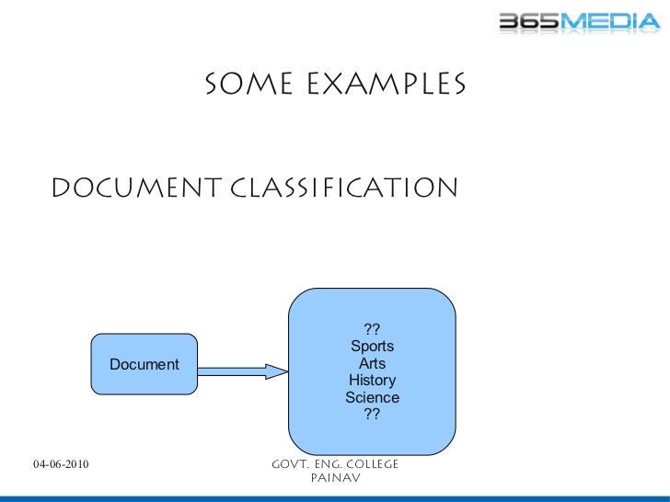

Slide 12
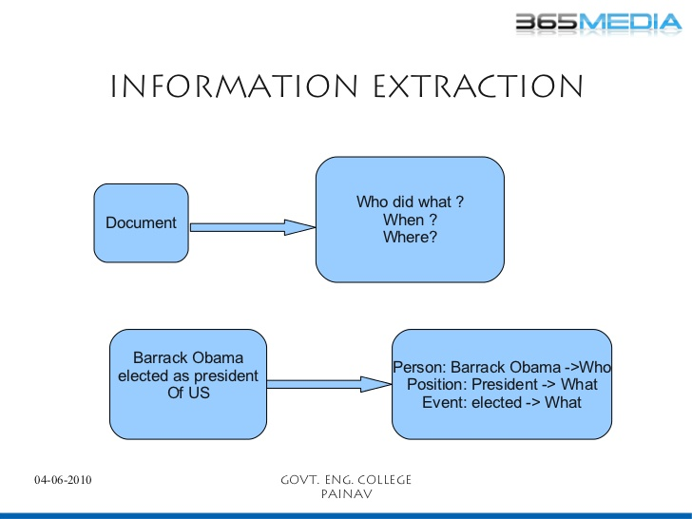

Slide 13
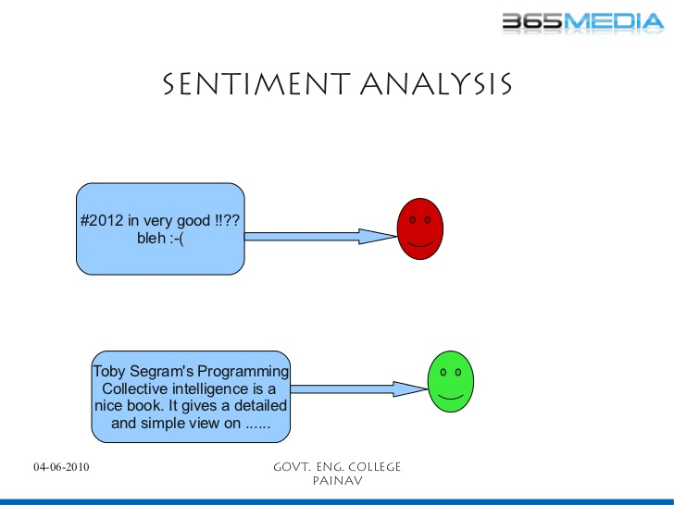

Slide 14
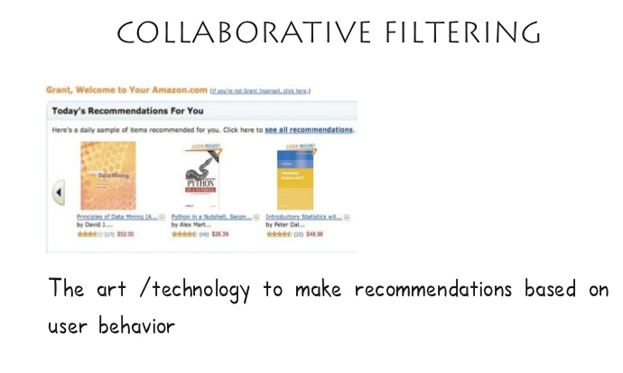

Slide 15
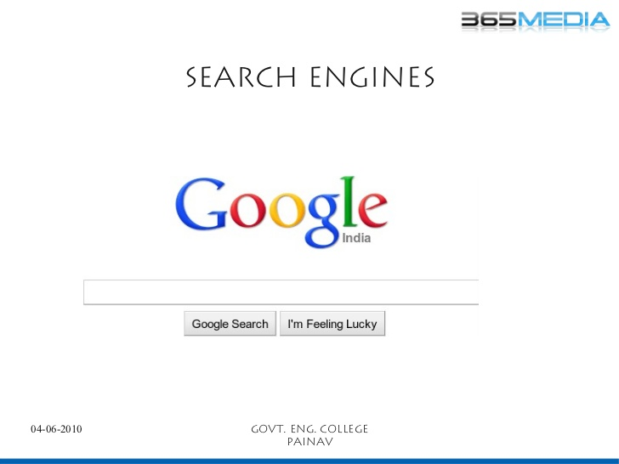

Slide 16
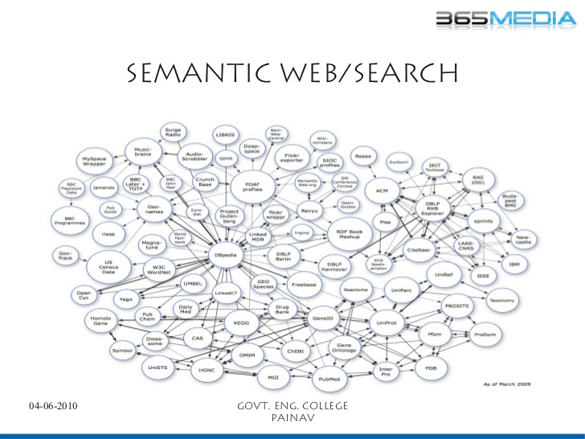

Slide 17
NLTK(Natural Language Toolkit)
A leading platform for building Python programs to work with human language data.
It provides easy-to-use interfaces to over 50 corpora and lexical resources such as WordNet, along with a suite of text processing libraries for classification, tokenization, stemming, tagging, parsing, and semantic reasoning.

Slide 18
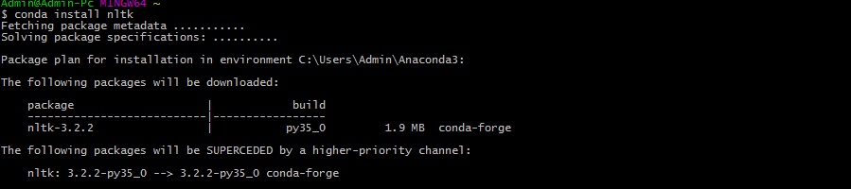
How to install NLTK?
1. $ conda install nltk
2. In ipython shell,
[1] : import nltk
[2] : nltk.download()
This will open a new window

Slide 19
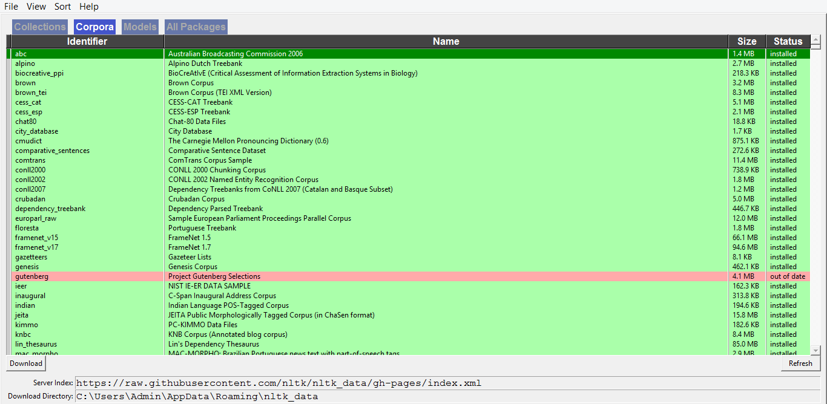

Slide 20
Demo

Slide 21
Twitter Sentiment Analysis
Part 1: Collecting Data
Register Your App
In order to have access to Twitter data programmatically, we need to create an app that interacts with the Twitter API.
The first step is the registration of your app. In particular, you need to point your browser to http://apps.twitter.com, log-in to Twitter (if you’re not already logged in) and register a new application.

Slide 22
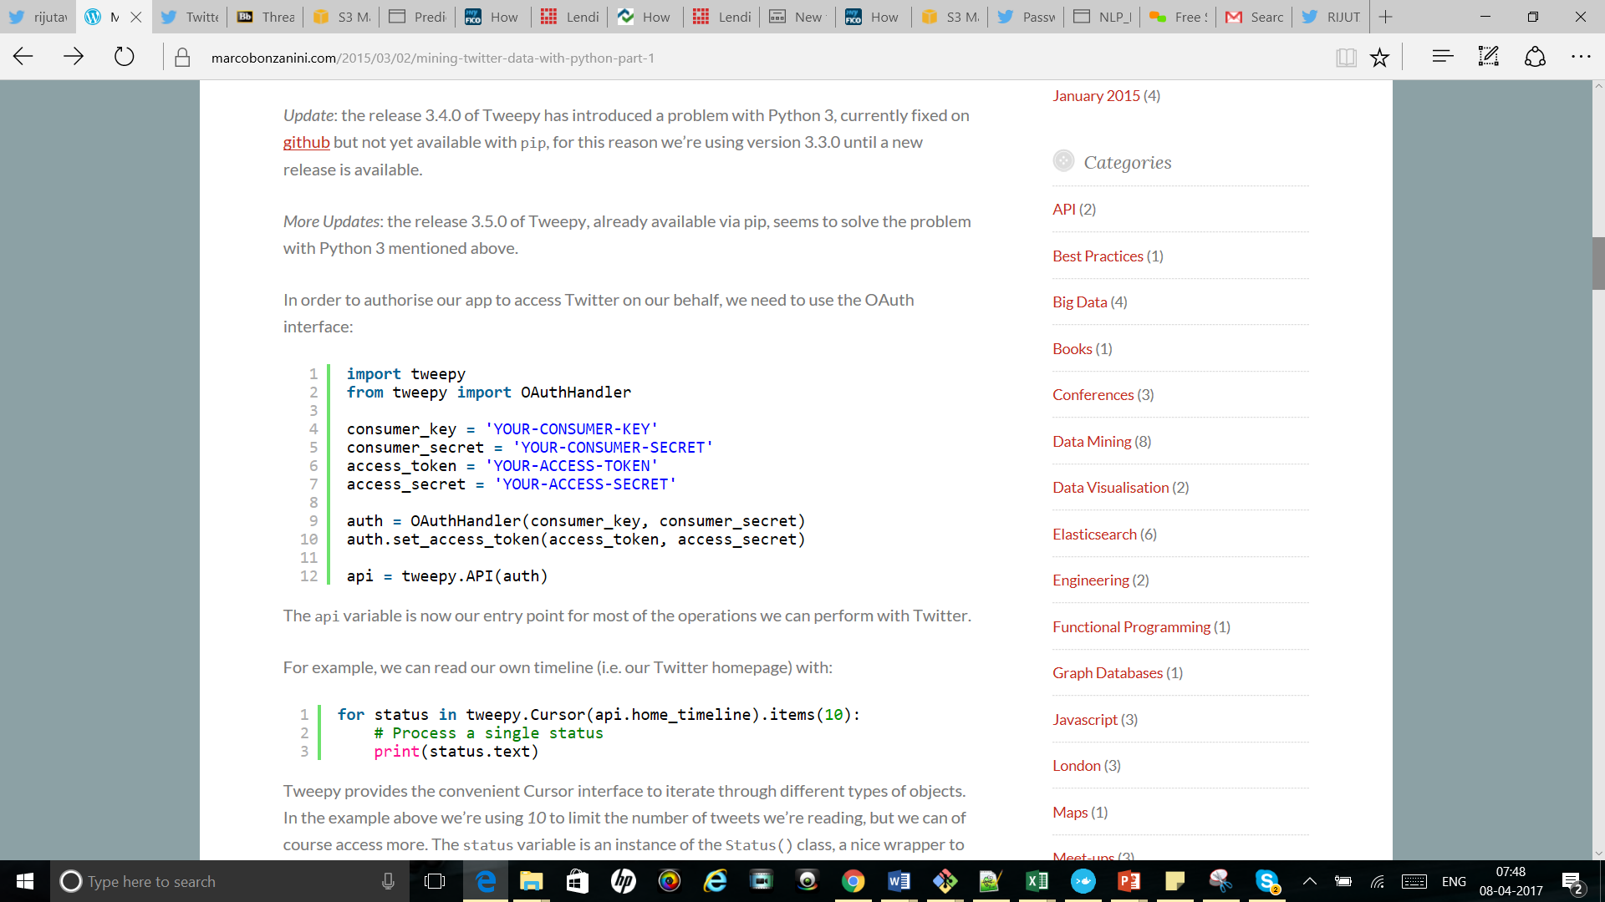
Accesing the data
pip install tweepy==3.3.0

Slide 23
Reading timeline(Twitter homepage)
Collecting Tweets
for status in tweepy.Cursor(api.home_timeline).items(10):
# Process a single status
print(status.text)
Processing and storing the JSON
for status in tweepy.Cursor(api.home_timeline).items(10):
# Process a single status
process_or_store(status._json)

Slide 24
What if we want to have list of followers?
List of all our followers
for friend in tweepy.Cursor(api.friends).items():
process_or_store(friend._json)
List of all Tweets
for tweet in tweepy.Cursor(api.user_timeline).items():
process_or_store(tweet._json)
Storing Tweets
def process_or_store(tweet):
print(json.dumps(tweet))

